Slide 1
Hotels in Madison Area

Slide 2
Data Cleaning Process
Merge review_city.json to business_city.json by corresponding business id
Select out the categories that contains hotels
Select out the business name that contains hotel, inn, Hilton, Courtyard, Edge, Place, Graduate, Wyndham, Suites, Motel, Lodge
Select out city = Madison, and drop the city and state column

Slide 3
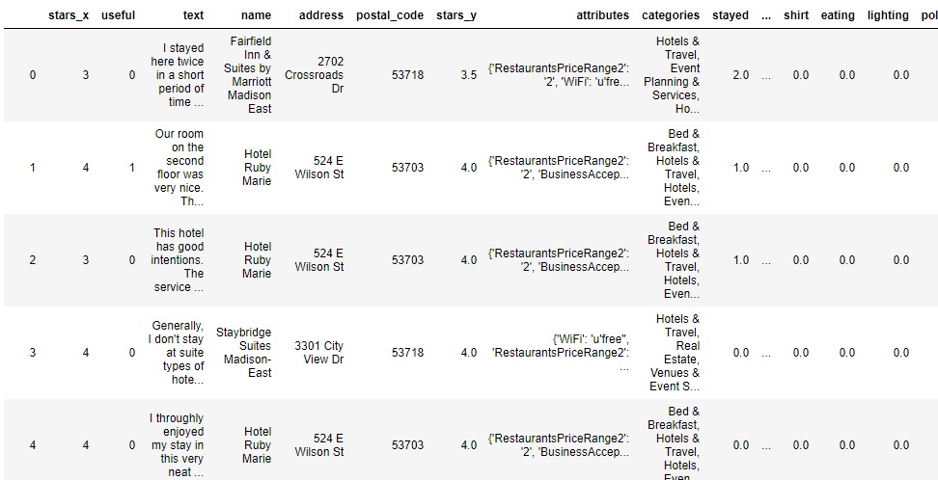
Data Cleaning Process
Drop all columns except rated star, review text, name, address, postal code, average a, attributes of business, categories of business.
Break the review text into word by word and get rid of stop words and special characters make it into matrix form.
Combine it to the original dataset

Slide 4
Data Analysis Process (Manipulating Cleaned Dataset)
1532 x 1405
1532 rows => reviews about hotels in Madison
1395 columns => Word Frequency
10 columns => About business

Slide 5
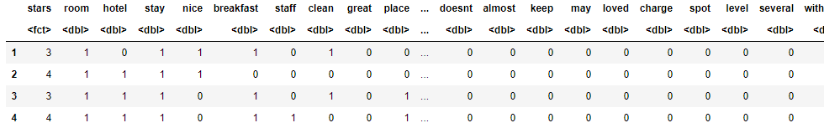
Data Analysis Process (Manipulating Cleaned Dataset)
1532 x 1405
1532 x 344

Slide 6
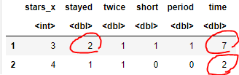
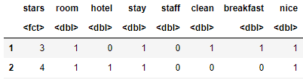
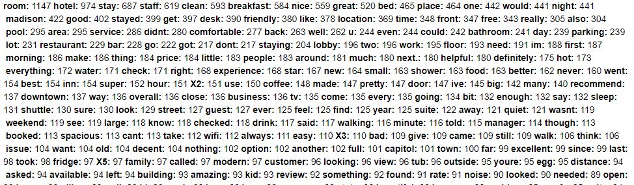

Data Analysis Process (Manipulating Cleaned Dataset)
1532 x 1405
1532 x 344
First, we reduced the overlapping count to 1
Second, we removed unmeaningful words, by selected out the words more used than 3rd quantile()reduced the repeated count to 1

Slide 7
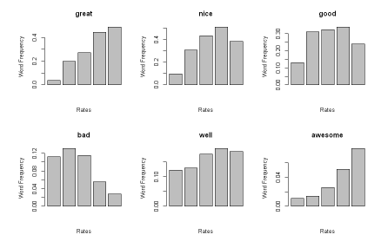
Data Analysis Process (EDA)
1. Words associated with service and furniture
Staff, service, manager, reservation, breakfast, coffee, drink, price, suite, bed, desk, wifi, tv, fridge, pillow, towel, booked, food, microwave, dinner, money, fruit, buffet, beer
2. Words associated with facility
Room, bathroom, pool, tub, shower, lobby, elevator, wall, parking, gym, amenity, size, light, car
3. Words associated with location
Shuttle, downtown, airport, distance, bar, location, restaurant, park, near, club
4. Words associated with atmosphere of hotels
Family, kid, business, clean, comfortable, small, pretty, quiet, beautiful, spacious, modern, noise, smell, comfy, week, weekend, dirty

Slide 8
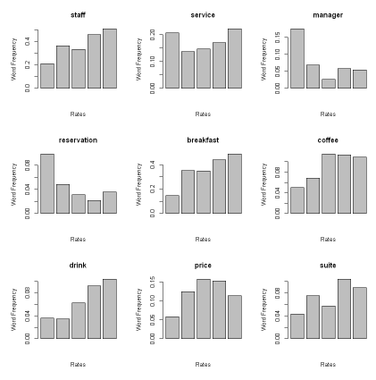
Data Analysis Process (EDA)
1. Words associated with service and furniture
Staff, service, manager, reservation, breakfast, coffee, drink, price, suite, bed, desk, wifi, tv, fridge, pillow, towel, booked, food, microwave, dinner, money, fruit, buffet, beer
2. Words associated with facility
Room, bathroom, pool, tub, shower, lobby, elevator, wall, parking, gym, amenity, size, light, car
3. Words associated with location
Shuttle, downtown, airport, distance, bar, location, restaurant, park, near, club
4. Words associated with atmosphere of hotels
Family, kid, business, clean, comfortable, small, pretty, quiet, beautiful, spacious, modern, noise, smell, comfy, week, weekend, dirty

